Slide 1
Introduction to philosophy Lecture 9
PHI1101
Dr. Lucas Scripter
Lecturer in General Education
School of Humanities and Social Sciences
Chinese University of Hong Kong, Shenzhen

Slide 2
pragmatism

Slide 3
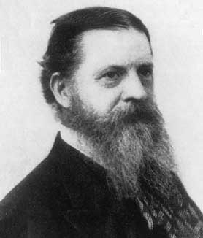
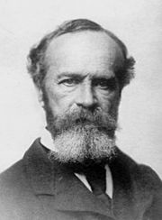
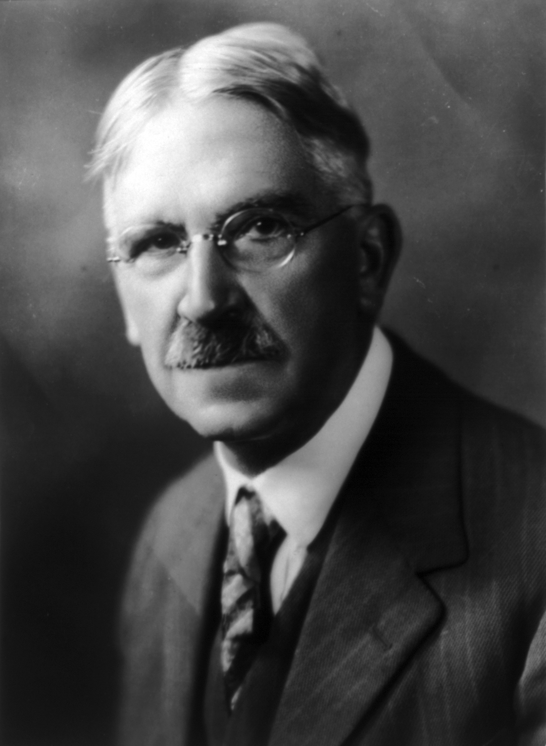
Major pragmatists
Charles Sanders Pierce
(1839-1914)
William James
(1842-1910)
John Dewey
(1859-1952)

Slide 4



Background: theories of truth
Correspondence Theory
A belief is true if and only if it corresponds or agrees to reality
Coherence
Theory
A belief is true if and only if it coheres with one’s other beliefs
Pragmatic
Theory
A belief is true if and only if it works.

Slide 5
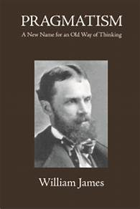
Key ideas of Pragmatism
Pragmatic Method
“The pragmatic method…is to try to interpret each notion by tracing its respective practical consequences. What difference would it practically make to any one if this notion rather than that notion were true? If no practical difference whatever can be traced, then the alternatives mean practically the same thing, and all dispute is idle.” (Pragmatism, p. 25)
Pragmatic view of Truth
“The true is the name of whatever proves itself to be good in the way of belief, and good, too, for definite, assignable reasons.” (Pragmatism, p. 38)

Slide 6
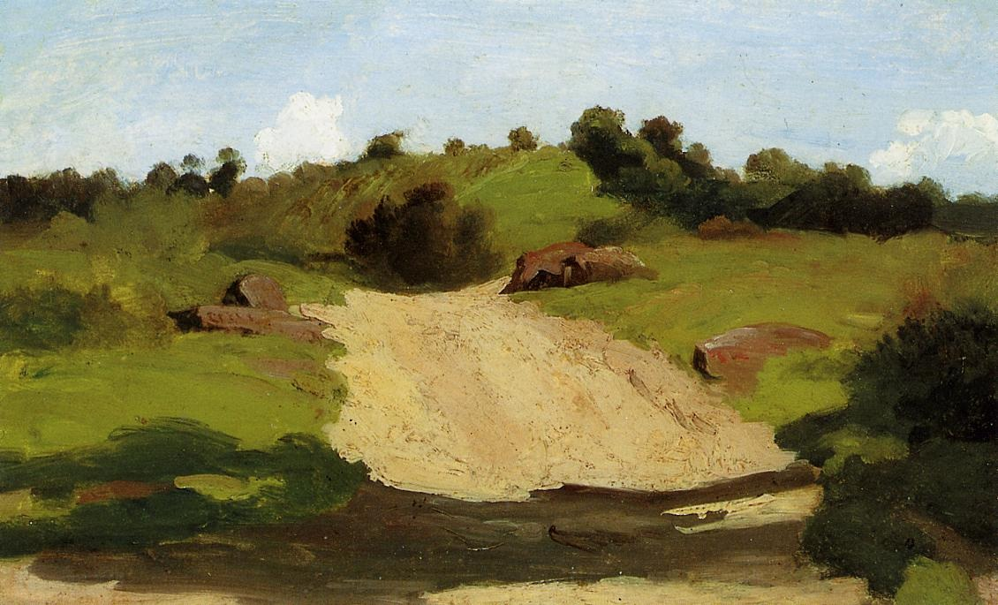
Practical interest in true beliefs
Example of Pragmatic View of Truth:
“The possession of truth, so far from being here an end in itself, is only a preliminary means towards other vital satisfactions. If I am lost in the woods and starved, and find what looks like a cow-path, it is of the utmost importance that I should think of a human habitation at the end of it, for if I do so and follow it, I save myself. The true thought is useful here because the house which is its object is useful. The practical value of true ideas is thus primarily derived from the practical importance of their objects to us.” (James, Pragmatism, p. 89)

Slide 7
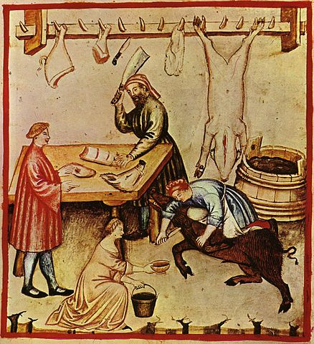
‘Agreement’ with reality
James argues that ‘agreement’ with reality should be understood as dealing with it successfully—not copying it.
“To copy a reality is, indeed, one very important way of agreeing with it, but it is far from being essential. The essential thing is the process of being guided. Any idea that helps us to deal whether practically or intellectually, with either the reality or the belongings, that doesn’t entangle our progress in frustrations, that fits, in fact, and adapts our life to the reality’s whole setting, will agree sufficiently to meet the requirement. It will hold true of that reality.” (Pragmatism, pp. 93-4)

Slide 8

Pragmatic view of truth 1: marrying-function
Double Function of the Pragmatic view of Truth: (a) account for new experiences and (b) preserve old stock of truths:
“A new opinion counts as ‘true’ just in proportion as it gratifies the individual’s desire to assimilate the novel in his experience to his beliefs in stock. It must both lean on old truth and grasp new fact…That new idea is truest which performs most felicitously its function of satisfying our double urgency.” (Pragmatism, pp. 32-3)

Slide 9


Truth, correction, and convergence
Which beliefs are true needs to be corrected as we encounter new experiences that cannot be dealt with smoothly with existing beliefs.
“Experience…has ways of boiling over, and making us correct our present formulas.” (Pragmatism, p. 98)
Truth is seen as an ideal point of convergence when no more experiences contradict our beliefs.
“The ‘absolutely’ true, meaning what no farther experience will ever alter, is that ideal vanishing-point towards which we imagine that all our temporary truths will some day converge.” (Pragmatism, p. 98)

Slide 10
Richard rorty’s pragmatism

Slide 11
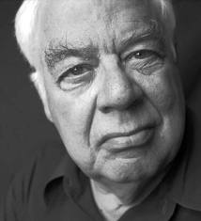
Richard Rorty’s major works
Philosophy and the Mirror of Nature (1979)
Consequences of Pragmatism (1982)
Contingency, Irony, and Solidarity (1989)
Objectivity, Relativism, and Truth: Philosophical Papers Vol. 1 (1991)
Essays on Heidegger and Others: Philosophical Papers Vol. 2 (1991)
Truth and Progress: Philosophical Papers Vol. 3 (1998)
Philosophy and Social Hope (2000)
Philosophy as Cultural Politics: Philosophical Papers Vol. 4 (2007)
Richard Rorty (1931-2007)

Slide 12

Rorty on his childhood

Slide 13
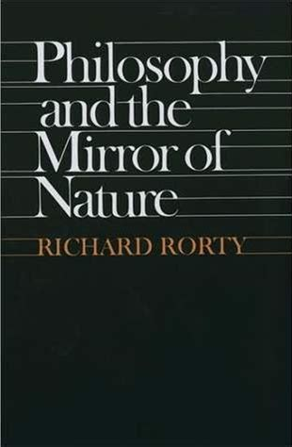
Critique of the ‘mirror of nature’
Rorty’s work Philosophy and the Mirror of Nature developed a pragmatist criticism of the assumption that epistemology involved ‘mirroring’ or ‘representing’ nature.
Rorty’s development of pragmatism drew on the analytic philosophical movement, especially Wittgenstein, Quine, and Sellars.
Compared to previous pragmatists, Rorty’s work is post-’linguistic turn’ and thus places a heavy emphasis on the place of language.

Slide 14


Rejecting the ‘mirror or nature’
Justification as mirroring
the world
Justification as a
social practice

Slide 15
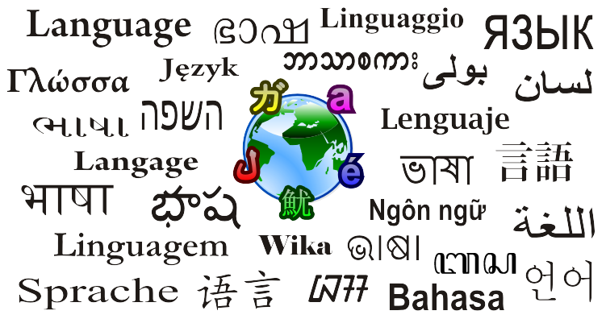
Critique of the correspondence theory of truth
Rorty rejects the idea that ‘truth’ involves a language mapping onto the world:
“To say that truth is not out there is simply to say that where there are no sentences there is no truth, that sentences are elements of human languages, and that human languages are human creations. Truth cannot be out there—cannot exist independently of the human mind—because sentences cannot so exist, or be out there. The world is out there, but descriptions of the world are not. Only descriptions of the world can be true and false. The world on its own—unaided by the describing activities of human beings—cannot.” (CIS, p. 5)

Slide 16
No meta-language for choosing vocabularies
“there is no way to step outside the various vocabularies we have employed and find a metavocabulary which somehow takes account of all possible vocabularies, all possible ways of judging and feeling.” (CIS, p. xvi)
“The world does not speak. Only we do. The world can, once we have programmed ourselves with a language, cause us to hold beliefs. But it cannot propose a language for us to speak. Only other human beings can do that. The realization that the world does not tell us what language games to play should not, however, lead us to say that a decision about which to play is arbitrary, nor to say that it is the expression of something deep within us. The moral is not that the objective criteria for choice of vocabulary should be replaced with subjective criteria, reasons with will or feeling. It is rather that the notion of criteria and choice (including that of ‘arbitrary’ choice) are no longer in point when it comes to changes from one language game to another. Europe did not decide to accept the idiom of Romantic poetry, or of socialist politics, or of Galilean mechanics. That short of shift was no more an act of will than it was a result of argument. Rather, Europe gradually lost the habit of using certain words and gradually acquired the habit of using others.” (CIS, p. 6)

Slide 17


Two interpretations of ‘objectivity’
Objectivity as Correspondence
A belief is objectively true if it correctly maps on to reality or the way things are.
Objectivity as Agreement
A belief is objectively true if it is reached by a rationally informed consensus.
(See PMN, pp. 333ff)

Slide 18
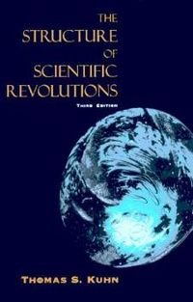
Normal and abnormal discourse
Modelling his argument based on Kuhn’s distinction between “normal science” and “abnormal science,” Rorty distinguishes between two types of human language use:
Normal Discourse (governed by agreed-upon conventions):
“Normal discourse…is any discourse (scientific, political, theological, or whatever) which embodies agreed-upon criteria for reaching agreement.” (PMN, p. 11)
“normal discourse is that which is conducted within an agreed-upon set of conventions about what counts as a relevant contribution, what counts as answering a question, what counts as having a good argument for that answer or a good criticism of it.” (PMN, p. 320)
Abnormal Discourse (not governed by agreed-upon conventions):
“abnormal discourse is any which lacks such criteria [for reaching agreement]” (PMN, p. 11)
“Abnormal discourse is what happens when someone joins in the discourse who is ignorant of these conventions or who sets them aside.” (PMN, p. 320)

Slide 19
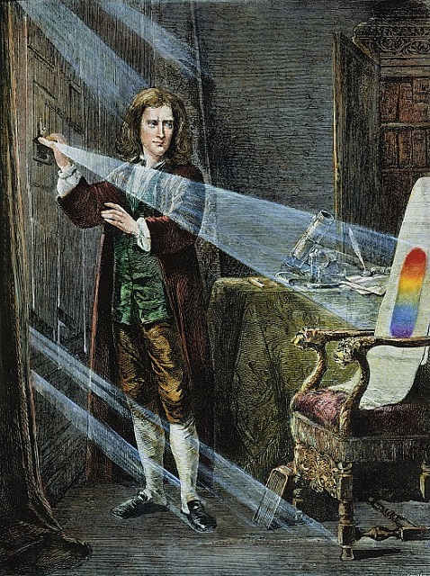
Rorty’s Instrumentalist view of Science
Rorty holds an instrumentalist view of science, i.e., certain ways of describing the world are more useful for certain predictions and technological developments without being truer or more real descriptions of the world as it is.
“the fact that Newton’s vocabulary lets us predict the world more easily than Aristotle’s does not mean that the world speaks Newtonian.” (CIS, p. 6)

Slide 20
Ethical/political implications of rorty’s pragmatism

Slide 21

Final vocabularies
Final Vocabulary: the terms of self-description and self-understanding that cannot be further justified in a non-circular manner:
“All human beings carry about a set of words which they employ to justify their actions, their beliefs, and their lives. These are the words in which we formulate praise of our friends and contempt for our enemies, our long term projects, our deepest self-doubts and our highest hopes. They are the words in which we tell, sometimes prospectively and sometimes retrospectively, the story of our lives.” (CIS, p. 73)

Slide 22
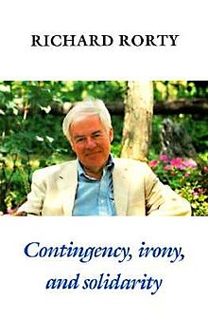
Rorty’s ironism
The Ironist: someone with self-reflective awareness and acceptance of the contingency of his/her final vocabulary.
“someone who fulfills three conditions: (1) She has radical and continuing doubts about the final vocabulary she currently uses, because she has been impressed by other vocabularies, vocabularies taken as final by people or books she has encountered; (2) she realizes that argument phrased in her present vocabulary can neither underwrite nor dissolve these doubts; (3) insofar as she philosophizes about her situation, she does not think that her vocabulary is closer to reality than others, that it is in touch with a power not herself.” (CIS, p. 73)
Irony
Common-Sense

Slide 23

Liberal ironism/ post-modern bourgeois liberalism
Rorty defends a view of liberal politics that does not believe a deeper, metaphysical grounding is either necessary or possible.
“liberals are the people who think that cruelty is the worst thing we do. I use ‘ironist’ to name the sort of person who faces up to the contingency of his or her most central beliefs and desires—someone sufficiently historicist and nominalist to have abandoned the idea that those central beliefs and desires refer back to something beyond the reach of time and chance. Liberal ironists are people who include among these ungroundable desires their own hope that suffering will be diminished, that the humiliation of human beings by other human beings may cease.” (CIS, p. xv)
Liberal Ironist
Critic of
Liberalism
Traditional
Liberal
(See Rorty, “Postmodern,
Bourgeois, Liberalism)

Slide 24



Rorty on human solidarity
Rorty thinks that literature (rather than philosophical theory) is more important for extending human solidarity, i.e., expanding our sense of ‘us’.
“Solidarity is not discovered by reflection but created. It is created by increasing our sensitivity to the particular details of the pain and humiliation of other, unfamiliar sorts of people…The process of coming to see other human beings as ‘one of us’ rather than as ‘them’ is just a matter of detailed description of what unfamiliar people are like and of description of what we ourselves are like. This is a task not for theory but for genres such as ethnography, the journalist’s report, the comic book, the docudrama, and, especially, the novel.” (CIS, xvi)

Slide 25

Rorty’s public/private distinction
Rorty thinks that the languages we use for self-creation and the languages we use for social solidarity cannot be unified. This results in a public/private distinction.
“there is no way to bring self-creation together with justice at the level of theory. The vocabulary of self-creation is necessarily private, unshared, unsuited to argument. The vocabulary of justice is necessarily public and shared, a medium for argumentative exchange.” (CIS, xiv)

Slide 26
Rorty’s view of philosophy

Slide 27
Challenging Philosophy’s self-image
Rorty thinks philosophy has the misperception that is foundational to culture:
“Philosophy as a discipline…sees itself as the attempt to underwrite or debunk claims to knowledge made by science, morality, art, or religion. It purports to do this on the basis of its special understanding of the nature of knowledge and mind. Philosophy can be foundational in respect to the rest of culture because culture is the assemblage of claims to knowledge, and philosophy adjudicates such claims.” (PMN, p. 3)
Other Fields of Knowledge (Scientific, Moral, etc.)
Philosophical Theory of Knowledge/Mind

Slide 28


Philosophy isn’t a ‘natural kind’
Richard Rorty (1998) has argued that Philosophy is not a “natural kind,” i.e., it doesn’t have some core features shared by all instances of philosophy.
What counts as ‘philosophy’ may change over time and be understood differently by different philosophers in different historical moments and cultures.
“We can think of the fundamental questions of philosophy as the ones everybody really ought to have asked, or as the ones everybody would have asked if they could, but not as the ones everybody did ask whether they knew it or not” (p. 262)

Slide 29


Two kinds of philosophy
Systematic Philosophy
Aims to provide a complete account.
Edifying Philosophy
Rejects ‘closure’ of knowledge; tries to change/revise/re-invent our vocabularies.
(See PMN, pp. 365ff)

Slide 30
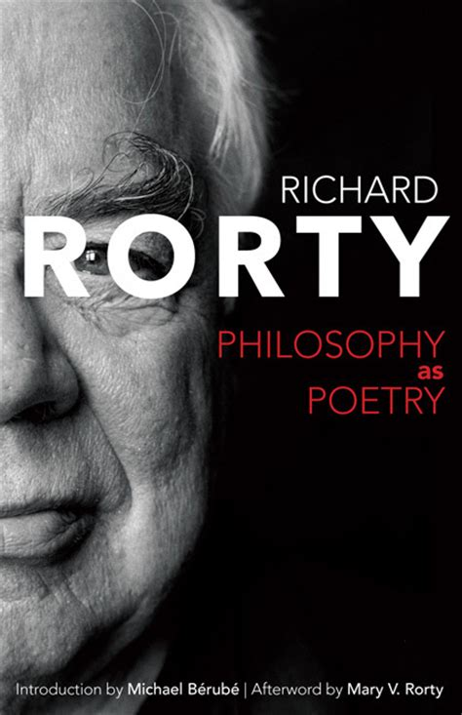
Philosophy as poetry

Slide 31
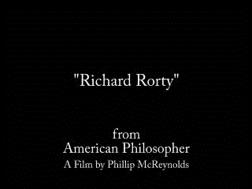
Remembrances of rorty

Slide 32
bibliography
James, W. (1907/2000). Pragmatism and Other Writings. Penguin.
Rorty, R. (1979) Philosophy and the Mirror of Nature. Princeton UP.
Rorty, R. (1989) Contingency, Irony, and Solidarity. Cambridge UP.
Rorty, R. (1991) Objectivity, Relativism, and Truth. Cambridge UP.
Rorty, R. (1998) Truth and Progress. Cambridge UP.
Rorty, R. (2016) Philosophy as Poetry. University of Virginia Press.

